Slide 1
Using Data to Improve Ethics Programs
Patrick Shepherd & Cheryl Kane-Piasecki
Senior Instructors

Slide 2
Allocating Resources

Slide 3
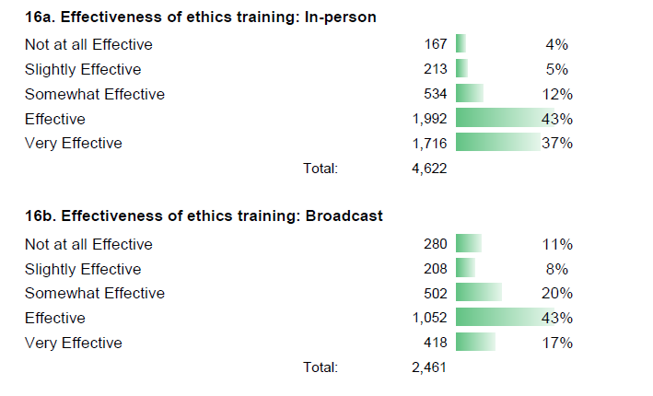
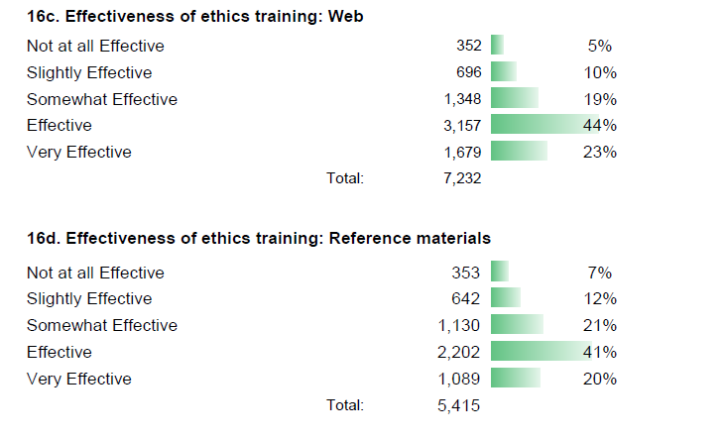

Slide 5
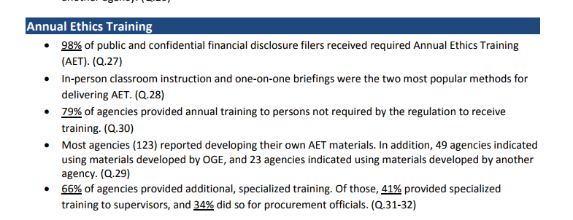

Slide 6
How do we make the argument?
Cost
In-person 1 HR:
30 Employees
+
1 Instructor
_________________
31 Employee Hours
Online 1 HR:
30 Employees
+
0 Instructor
_________________
30 Employee Hours

Slide 7
How do we make the argument?
Cost
+3.3% Employee Hours
In-person 1 HR:
30 Employees
+
1 Instructor
_________________
31 Employee Hours
Online 1 HR:
30 Employees
+
0 Instructor
_________________
30 Employee Hours

Slide 8
How do we make the argument?
Cost
Effectiveness
+3.3% Employee Hours
In-person 1 HR:
30 Employees
+
1 Instructor
_________________
31 Employee Hours
In-person 1 HR:
80% Effective or Very Effective
Online 1 HR:
30 Employees
+
0 Instructor
_________________
30 Employee Hours
Online 1 HR:
67% Effective or Very Effective

Slide 9
How do we make the argument?
Cost
Effectiveness
+3.3% Employee Hours
In-person 1 HR:
30 Employees
+
1 Instructor
_________________
31 Employee Hours
+13% Effectiveness
In-person 1 HR:
80% Effective or Very Effective
Online 1 HR:
30 Employees
+
0 Instructor
_________________
30 Employee Hours
Online 1 HR:
67% Effective or Very Effective

Slide 10
How do we make the argument?
Cost
Effectiveness
+3.3% Employee Hours
In-person 1 HR:
30 Employees
+
1 Instructor
_________________
31 Employee Hours
+13% Effectiveness
An increased investment of 3.3% leads to a 13% increase in effectiveness!
In-person 1 HR:
80% Effective or Very Effective
Online 1 HR:
30 Employees
+
0 Instructor
_________________
30 Employee Hours
Online 1 HR:
67% Effective or Very Effective

Slide 11
Advocate for Support

Slide 12
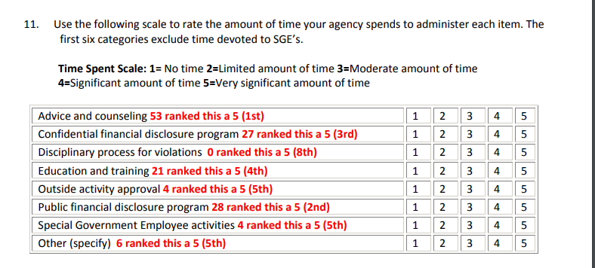
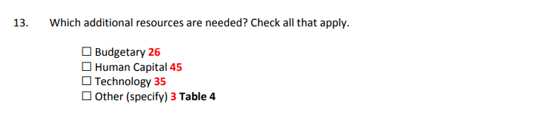
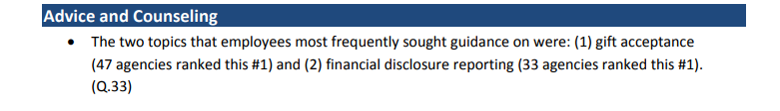

Slide 14
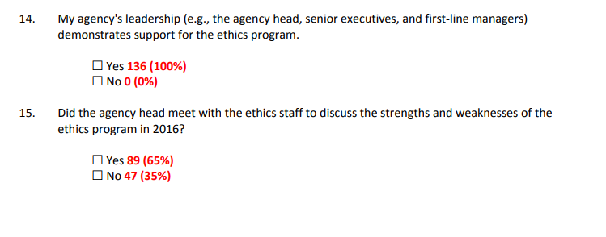
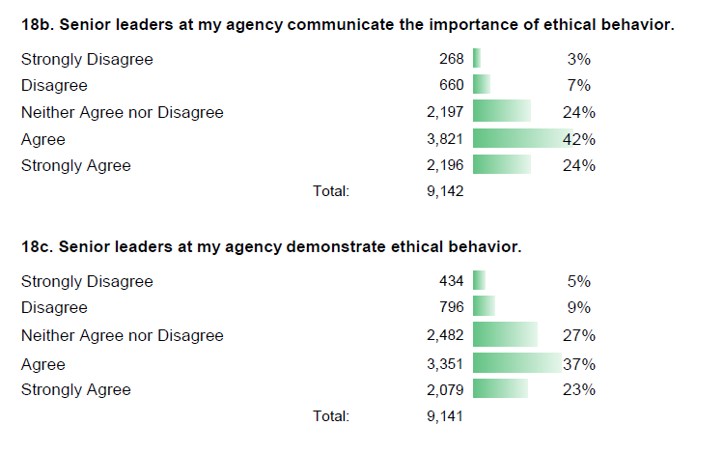

Slide 16
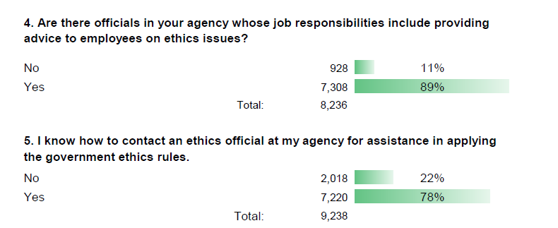
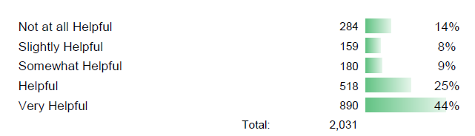

Slide 17
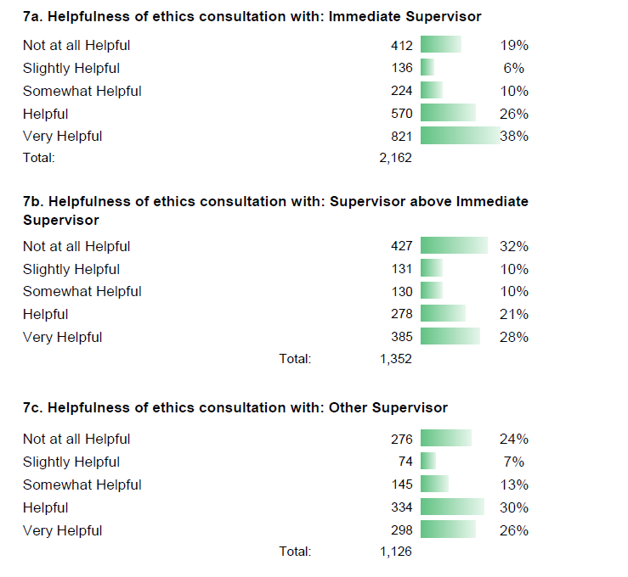

Slide 18
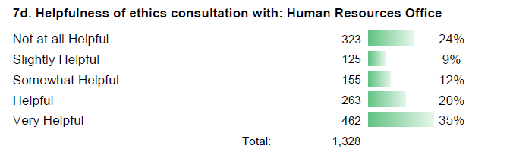

Slide 19
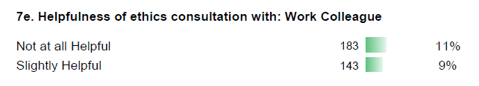
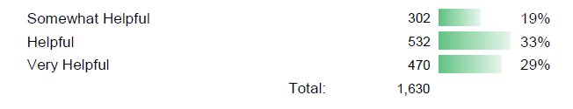

Slide 20
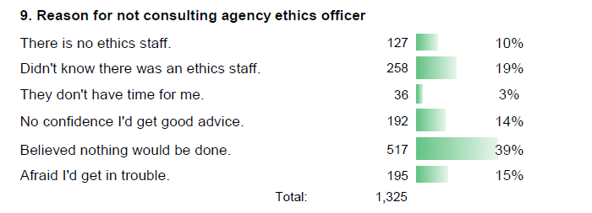

Slide 21
Staff Development

Slide 22
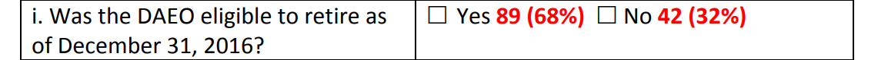

Slide 23
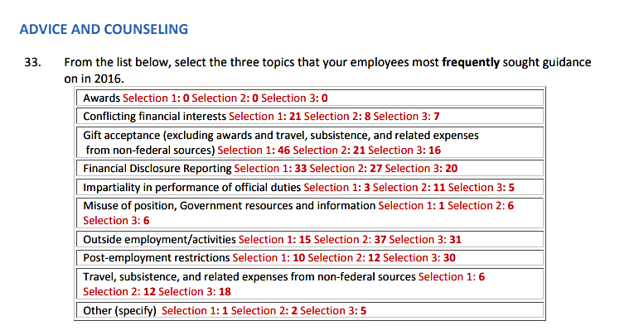

Slide 26
Identify Risk Areas

Slide 27
I can disclose a suspected violation of any law, rule or regulation without fear of reprisal.

Slide 28
Arbitrary action, personal favoritism and coercion for partisan political purposes are not tolerated.

Slide 29
Prohibited Personnel Practices (for example, illegally discriminating for or against any employee/applicant, obstructing a person's right to compete for employment, knowingly violating veterans' preference requirements) are not tolerated.

Slide 30
My organization's senior leaders maintain high standards of honesty and integrity.

Slide 31
I have a high level of respect for my organization's senior leaders.

Slide 32
Join us.

Slide 33
Thank you.

